Slide 1
Case Study for PayPal
Jayavignesh G
jayavigneshg@gmail.com
pH:+91 8939850980

Slide 2
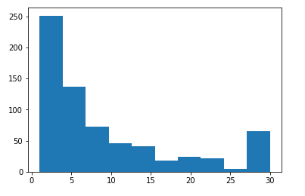
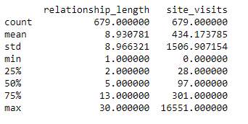
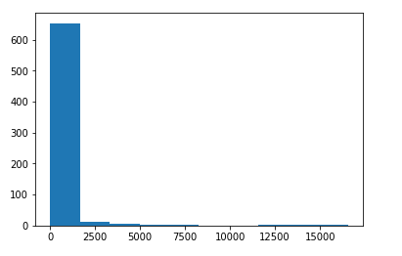
Initial Data Analysis: The data from Vendor looks well diverse and it’s a left-skewed distributon. Below are some analysis done in Python.
relationship_length
site_visits

Slide 3
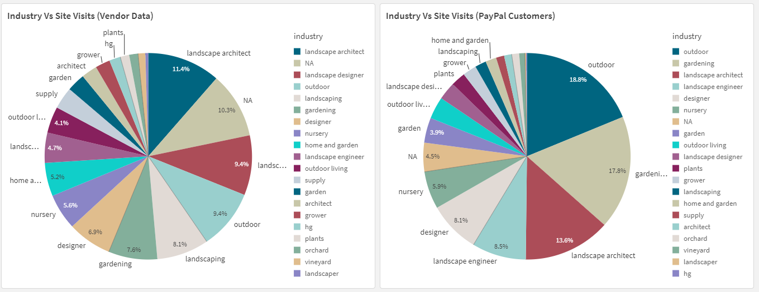
Descriptive Analysis using Qlik Sense: Vendor seem to have well diversified industries on their subscriber base. This shows that the vendor has a good reach in the market. The second pie chart shows that PayPal customers from almost all industries are subscribed to this vendor.

Slide 4
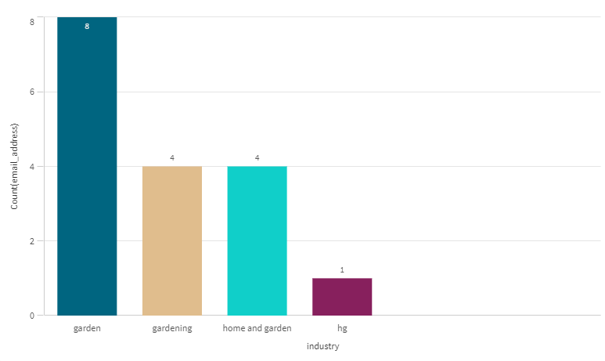
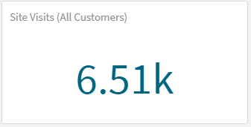
Industry to deep dive – Home and Gardening: The deep dive analysis was made into ‘home and garden’, ‘garden’, gardening’ and ‘hg’ industries only for PayPal customers (either with active send or receive). We have in total 17 customers with no.of.site visits more than 6.5K. Considering the fact that this is only the sample subscribers data from vendor (2.26% of original data i.e. 680 out of 30K) the number of site visits for PayPal active customer for this vendor looks very good.

Slide 5
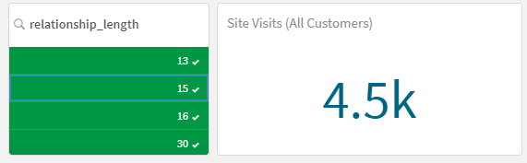
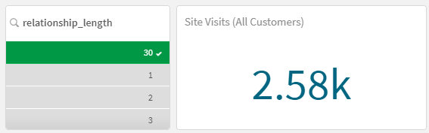
Customer with more than 10 years of relationship with Vendor: The no.of.site visits for customers having more than 10 years subscription with vendor is already 4.5K. If we scale it up for entire population of vendor data it could be that this vendor is one of the large sales contributor for PayPal business.
Customer with more 30+ years of relationship with Vendor: There are 3 customer who is having 30 years of relationship with this vendor and are considered to be having very strong potential to contribute to the sales. Again, if we only scale this customer base for population, this vendor is holding good medium business for us.

Slide 6
Inference :
Looks like there is a lot of rationale exists for me to discuss this vendor proposal with my Boss and thus by generating a good sales lead for PayPal into Home & Garden vertical.

Slide 7
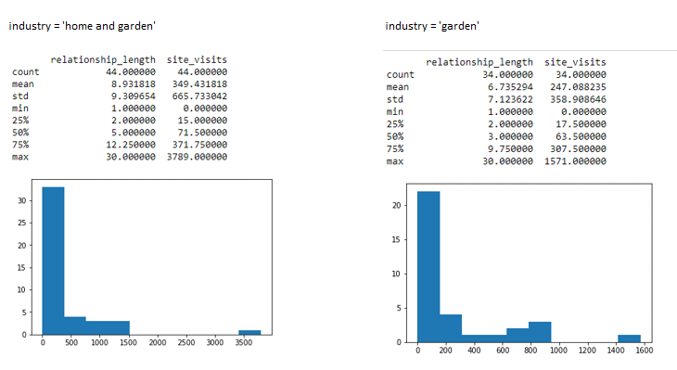
Appendix1: The analysis using Python pandas to understand the mean, median and IQR’s for home and garden vertical in vendor data.

Slide 8
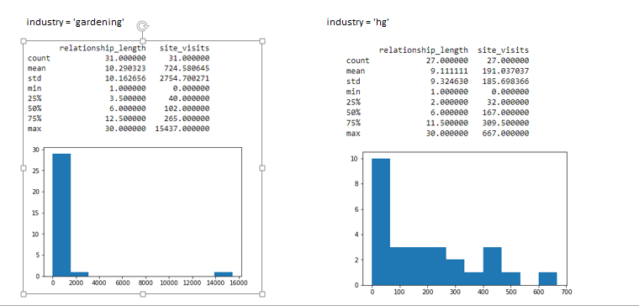
Appendix2: The analysis using Python pandas to understand the mean, median and IQR’s for home and garden vertical in vendor data.

Slide 9
Thank you!

